Slide 1
Microsoft Graph Capabilities
Working with Microsoft Graph delta queries

Slide 2
Working with Microsoft Graph delta queries
Optional query parameters
Paging with nextLink
Change tokens with deltaLink
Supported resources for delta queries

Slide 3
Working with Microsoft Graph delta queries

Slide 4
Optional query parameters
Name | Description | Example
$count | Retrieves the total count of matching resources | /me/messages?$top=2&count=true
$expand | Retrieves related resources | /groups?$expand=members
$filter | Filters results (rows) | /users?$filter=startsWith(givenName,’J’)
$orderBy | Orders results | /users?$orderBy=displayName desc
$search | Returns results based on search criteria. Currently supported on messages and person collections | /me/messages?$search=pizza
$select | Filters properties (columns) | /users?$select=givenName,surname
$skip | Indexes into a result set, also used by some APIs to implement paging and can be used together with $top to manually page results | /me/messages?$skip=11
$skipToken | Retrieves the next page of results from result sets that span multiple pages.(Some APIs use $skip instead) | https://graph.microsoft.com/v1.0/users? $skiptoken=X%27445370 ... 0000000%27
$top | Sets the page size of results | /users?$top=10
Notes:
For additional details, see https://developer.microsoft.com/en-us/graph/docs/concepts/query_parameters

Slide 5
$filter
Support for $filter varies across Microsoft Graph APIs, but the following are generally supported:
Equals – eq
Not equals – ne
Greater than – gt
Greater than or equals – ge
Less than – lt
Less than or equals – le
And – and
Or – or
Not - not
Notes:
https://developer.microsoft.com/en-us/graph/docs/concepts/query_parameters#filter

Slide 6
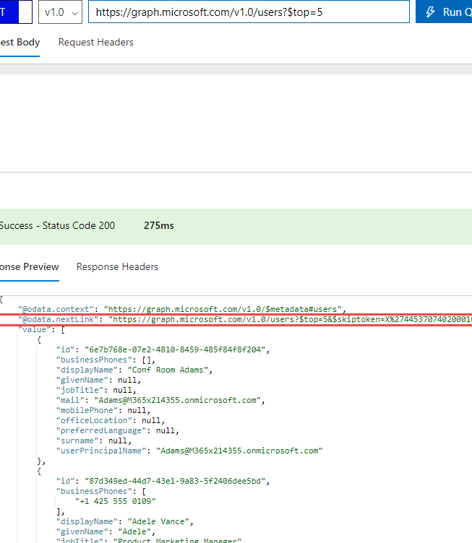
Paging with nextLink
Paging with Microsoft Graph
Some queries return multiple pages of data
Page size is specified using $top query parameter
@odata.nextLink
Presence indicates there are additional pages of data
Provides full URL link to next page of data
API behavior
Not all APIs support paging
Different default and max page sizes
Some support backwards paging (&previous-page=true)
Notes:
See https://developer.microsoft.com/en-us/graph/docs/concepts/paging
Some queries against Microsoft Graph return multiple pages of data either due to server-side paging or due to the use of the $top query parameter to specifically limit the page size in a request. When a result set spans multiple pages, Microsoft Graph returns an @odata.nextLink property in the response that contains a URL to the next page of results.
Paging behavior varies across different Microsoft Graph APIs. Consider the following when working with paged data:
Different APIs might have different default and maximum page sizes.
Different APIs might behave differently if you specify a page size (via the $top query parameter) that exceeds the maximum page size for that API. Depending on the API, the requested page size might be ignored, it might default to the maximum page size for that API, or Microsoft Graph might return an error.
Not all resources or relationships support paging. For example, queries against directoryRoles do not support paging. This includes reading role objects themselves as well as role members.
Some Microsoft Graph APIs support backward paging by appending the previous-page query parameter (&previous-page=true) to the URL value of the @odata:nextLink property. After you append this parameter to a request, the @odata:nextLink URL value in subsequent responses will include it. You can continue to page backward until a response with an empty result is returned. Paging further will return an error. Alternatively, you can resume paging forward from the current response by removing the previous-page parameter when you send the request for the next page of results.

Slide 7
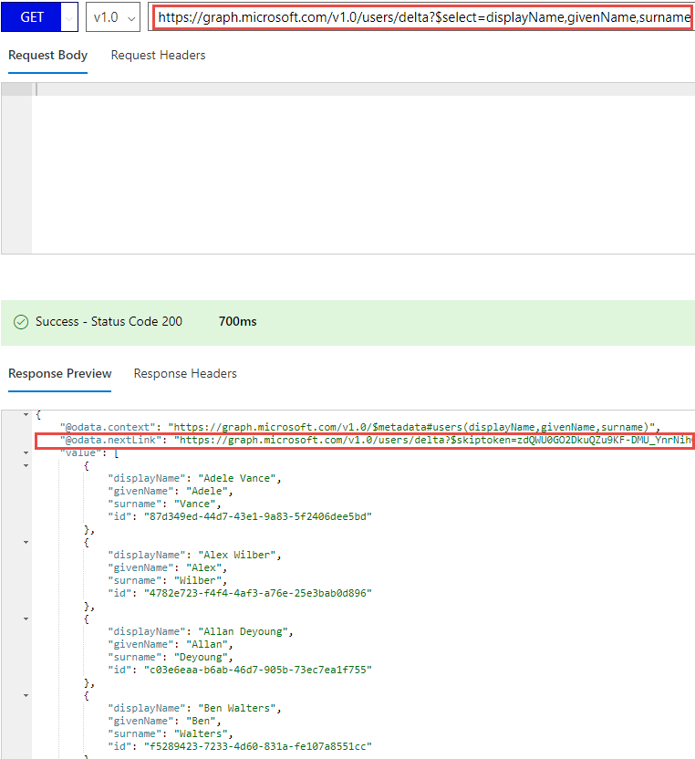
Change tokens with deltaLink
Delta queries
Discover newly created, updated, or deleted entities without a full read of the target resource
Useful for synchronizing changes to a local data store
Requires permission to read the requested resource
@odata.nextLink
The $select query parameter from the intial request is encoded into the nextLink URL
Presence of nextLink indicates more data is available
@odata.deltaLink
Presence of deltaLink indicates no more data to be returned
Contains deltaToken, save this for future queries
If no changes have occurred, the same deltaToken is returned with no results
Notes:
See https://developer.microsoft.com/en-us/graph/docs/concepts/delta_query_overview
The typical call pattern is as follows:
The application begins by calling a GET request with the delta function on the desired resource.
Microsoft Graph sends a response containing the requested resource and a state token.
If a nextLink URL is returned, there may be additional pages of data to be retrieved in the session. The application continues making requests using the nextLink URL to retrieve all pages of data until a deltaLink URL is returned in the response.
If a deltaLink URL is returned, there is no more data about the existing state of the resource to be returned. For future requests, the application uses the deltaLink URL to learn about changes to the resource.
When the application needs to learn about changes to the resource, it makes a new request using the deltaLink URL received in step 2. This request may be made immediately after completing step 2 or when the application checks for changes.
Microsoft Graph returns a response describing changes to the resource since the previous request, and either a nextLink URL or a deltaLink URL.

Slide 8
Typical call pattern to track changes in a resource collection
Application
https://graph.microsoft.com/v1.0
/{resource}/delta?$select=id,displayName
{“@odata.nextLink”:”https://graph.Microsoft.com/v1.0/{resource}/delta?$skipToken=ABC”,
“value”:[{“id”:”1”,”displayName”:”foo”}, {“id”:”2”,”displayName”:”bar”}]}
https://graph.Microsoft.com/v1.0/{resource}/delta?$skipToken=ABC
{“@odata.deltaLink”:”https://graph.Microsoft.com/v1.0/{resource}/delta?$deltaToken=DEF”,
“value”:[{“id”:”3”,”displayName”:”baz”}]}
Some time later
https://graph.Microsoft.com/v1.0/{resource}/delta?$deltaToken=DEF
{“@odata.deltaLink”:”https://graph.Microsoft.com/v1.0/{resource}/delta?$deltaToken=XYZ”,
“value”:[{“id”:”1”,”displayName”:”My data was updated”}]}
Notes:
Delta query is made to a collection of resources, specifying properties in the select
Data is returned along with a nextLink response header, indicating there is more data available
The nextLink is queried (which encodes the select in it), returns data and a deltaLink response header, indicating no further data is available
After some time, the application queries for changes again by querying using the same deltaLink. A single record is returned indicating a change, along with a new deltaToken.

Slide 9
Resources that support delta queries
Resource collection | API
Events in a calendar view (date range) of the primary calendar | Delta function of the event resource
Groups | Delta function of the group resource
Mail folders | Delta function of the mailFolder resource
Messages in a folder | Delta function of the message resource
Personal contact folders | Delta function of the contactFolder resource
Personal contacts in a folder | Delta function of the contact resource
Users | Delta function of the user resource
Drive items | * Delta function of the driveItem resource
* Delta queries for drives will be updated in the future to be consistent with other resource types
Notes:
* The usage pattern for OneDrive resources is similar to the other supported resources with some minor syntax differences. Delta query for drives will be updated in the future to be consistent with other resource types. For more detail about the current syntax, please see: https://developer.microsoft.com/en-us/graph/docs/api-reference/v1.0/api/item_delta

Slide 10
Demo

Slide 11
Summary
Delta queries return @odata.nextLink response header if there is more data, includes skipToken
Delta queries return @odata.deltaLink response header if there is no more data, includes deltaToken
Use the @odata.deltaLink for future change queries

